Slide 1

Data Science for Public Good Summer Program

Slide 2

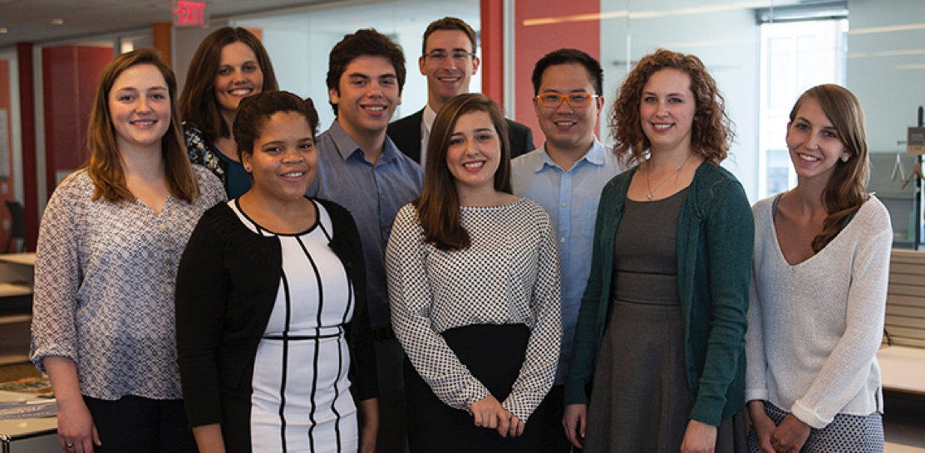
Data Science for Public Good Summer Program

Slide 3
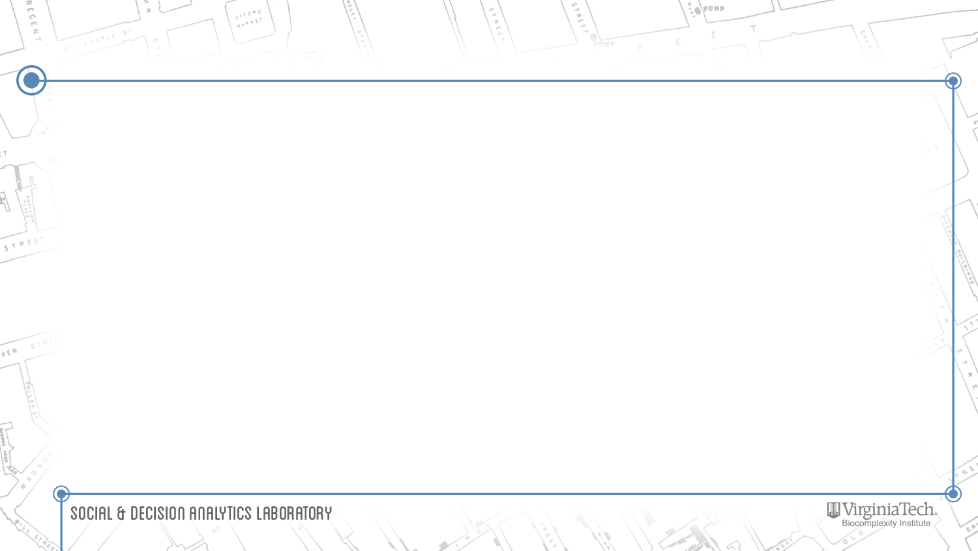

DSPG Summer Program
"The collaborative nature of the lab provides students with a holistic and diversified experience which prepares them to contribute meaningfully to research projects. Each research scientist at the lab contributes a unique perspective, enriching both the projects we work on, as well as the interests and aspirations of the students in the program. This access to a professional network has extended far beyond my summer experience, and reaches across many universities and institutions."
- Madison Arnsberger, DSPG Fellow 2016

Slide 4
DSPG Program Overview
Ten weeks from May 22 to July 28, 2017, in Arlington, VA
paid fellowship graduate national search working directly with faculty, undergrads from VT (Honors program) receive credits
Team research with dedicated graduate students, postdocs and faculty
Horizontally and vertically integrated teams (multidisciplinary), in collaboration with sponsors
Individualized mentors working closely with students
Participation in all the laboratory’s project activities
Professional training through development workshops and seminars
Final presentation of research projects at closing poster session (https://www.bi.vt.edu/sdal/careers/call-for-students/student-poster-presentations note to creative team: Poster Session on the news)
Technical report and publication opportunities (AMSTAT article)

Slide 5
Who Is Eligible?
The DSPG program is open to two groups of students:
Undergraduate students currently enrolled in Virginia Tech's Honors Program
Graduate students currently enrolled at any U.S. university can apply for our funded fellowship positions by following the application process outlined directly below.
DSPG Alumni previously enrolled students interested in taking part in DSPG program again.

Slide 6
DSPG Fellow Applications
Deadline: February 1, 2017.
Requirement is to have a completed bachelor's degree in any discipline from an accredited academic institution or be actively enrolled as a master's or PhD student at a U.S. university.
Complete our online application and diversity data survey.
Request two personal references (teachers, mentors, or employers)

Slide 7
DSPG Honors Program Applications
Deadline: March 1, 2017.
Requirement is to enroll in the following courses during the Summer I and Summer II semesters:
Summer I UH 4504: Honors Discovery and Innovation Studio (3 credits) UH 4994: Honors Undergraduate Research (3 credits)
Summer II UH 4504: Honors Discovery and Innovation Studio (3 credits) UH 4994: Honors Undergraduate Research (3 credits)

Slide 8
Make a Real Impact
An opportunity to pursue community-based research projects which inform ethical policymaking and address real-world problems.(https://www.bi.vt.edu/sdal/projects)
Our projects help guide the creation of resilient communities, inform effective policy responses to public health crises, and uncover key factors that drive industrial innovation.
“While classwork is heavy on numbers, being able to work directly with people at Arlington County government is eye-opening. It gives you a broader context and changes your world view.”
- Adrienne Rogers, DSPG Fellow 2015

Slide 9
Diversify Your Expertise
Individualized mentors in a wide variety of fields: statistics, social, behavioral and economic sciences, computer science, simulation, data analytics, information technology policy, and infrastructural resilience.
"The interdisciplinary work environment made it easy to connect and have conversations. If I wanted to ask a question about another field of research, there was always a door I could knock on."
- DSPG Fellow 2016

Slide 10
Experience Team Science
Work in a vertically and horizontally integrated team environment—our project groups combine diverse levels of experience (students, post-docs, researchers, and federal leaders) with a range of academic perspectives (data science, statistics, and social sciences.)
"We never felt limited by our individual skill sets because collaboration provided so many natural opportunities for us to learn from one another. Colleagues with a background in statistics would teach those of us with experience in computer programming and vice versa."
- DSPG Fellow 2016

Slide 11
Form Professional Connections
Engagement with practitioners and researchers through SDAL’s Visiting Scholar program, which includes economists, statisticians, and other social science researchers with diverse federal and private sector experience.
Direct interaction with decision-makers in industry and government agencies through field trips and regular policy events on Capitol Hill and the surrounding area.

Slide 12
Resources
Training in essential tools for scientific and statistical computing such as Hadoop, R, Python, GIS, other software tools as needed for projects
Access to a state-of-the-art parallel cluster with high-performance interconnect in the Biocomplexity Institute of Virginia Tech’s High-Performance Computing Facility

Slide 13
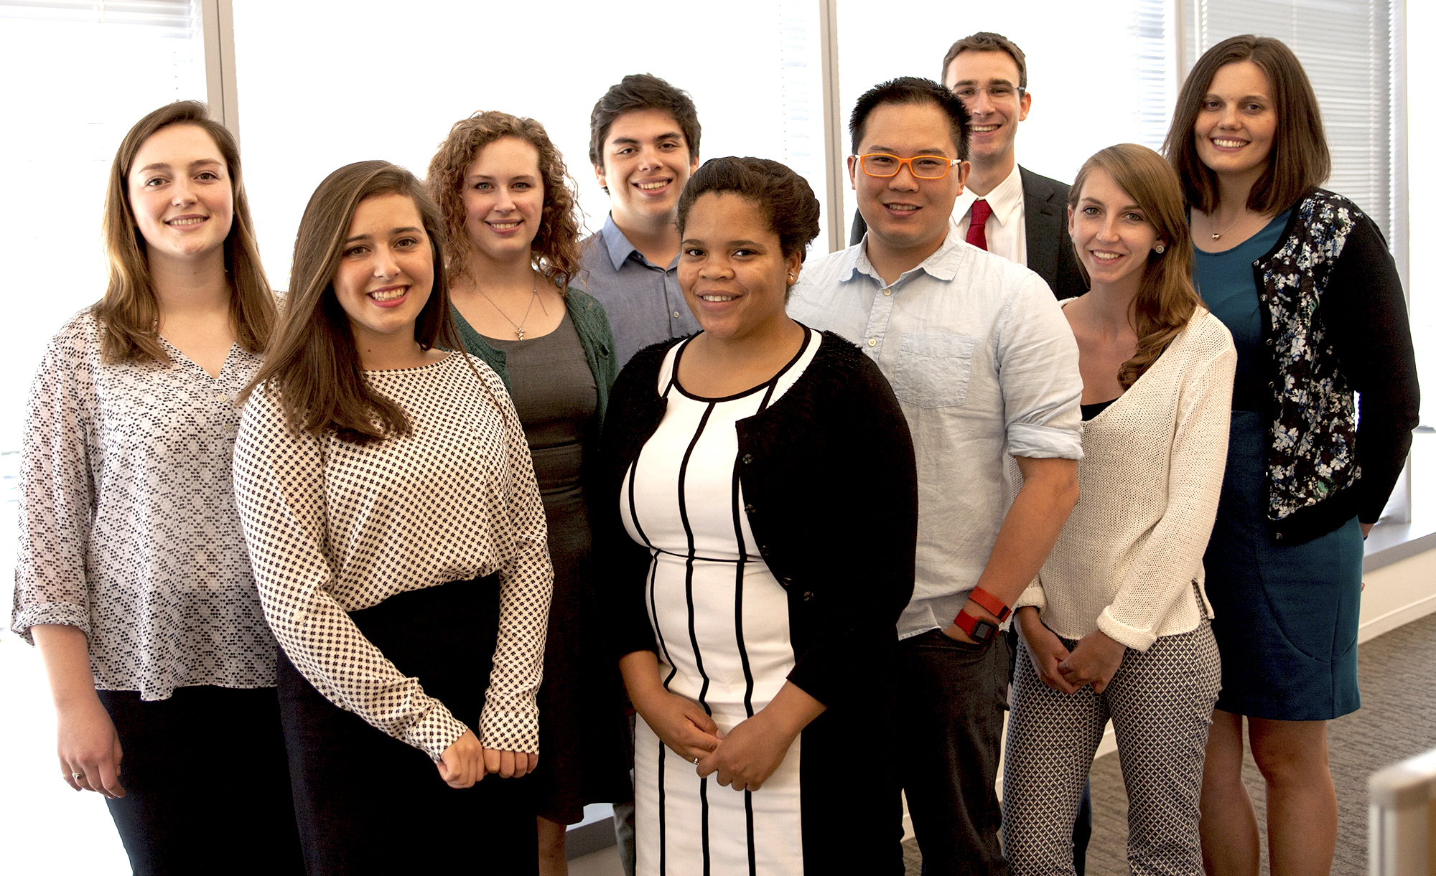
Selected Research Projects from DSPG 2016

Slide 14
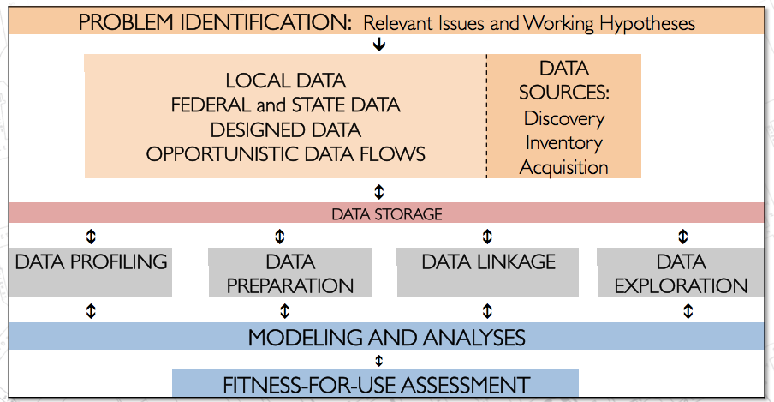
Research Method
Projects start with engagement with community leaders, and identification of the research questions.
Review of literature to identify current practice and working hypotheses.
Identify data sources (i.e., designed data collections, administrative, opportunity, and procedural data) for inventory, acquisition, and preparation.
Address questions through modeling and analyses.

Slide 15
Arlington County FIRE/EMS 911 Data

Slide 16
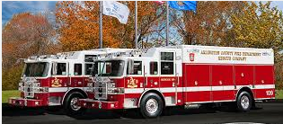
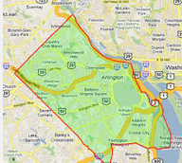
Arlington County Fire Department
Improve quality of life and services while accelerating the county’s efficiency and resiliency
Situational Awareness
Emergency 911 calls
Non-profit networks and social cohesion of neighborhoods
Map the “age” of the county

Slide 17
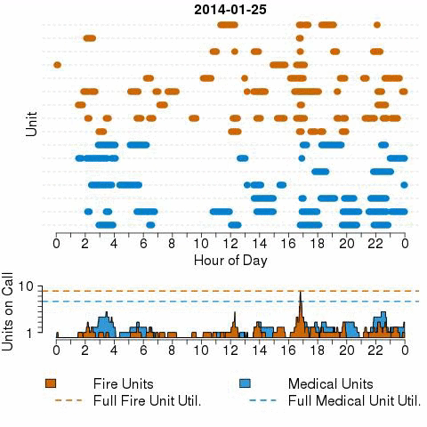
Linking Incident Linked Across Time
Minutes on Call

Slide 18
PREDICTING SMOKE ALARM NEED IN ARLINGTON COUNTY

Slide 19
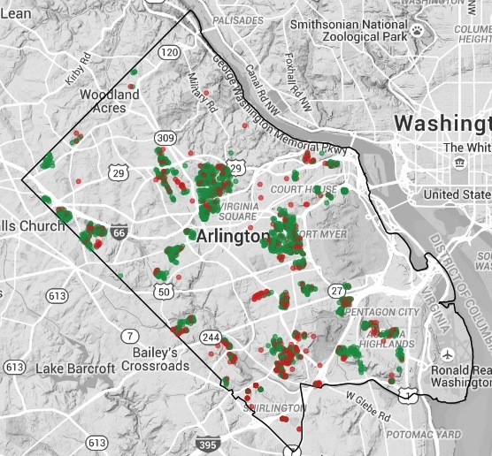
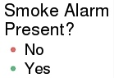
Arlington Operation FireSafe
Goal: to increase the number of residences in Arlington with smoke alarms
Build a predictive model to identify homes most in need of an alarm
Data Sources:
Operation FireSafe - Arlington County Fire Department visited 1733 homes, 32% did not have an alarm
Housing data - house value, size, age, number of bedrooms, and tenure for 60,343 housing units in Arlington County
ACS 2014 – demographic (age, sex, race) and socioeconomic variables (income, poverty, education, SNAP, household composition) at the block group
Notes:
The goal for Operation Firesafe is to increase the number of residences in Arlington with smoke alarms
Arlington County Fire Department visited 1733 homes, 32% did not have fire alarm. Fortunately for us, they collected data about this!
We mapped the Operation Firesafe data with Housing data such as house value, size, age, number of bedrooms, and ownership, for 60,343 housing units in Arlington County
Added in demographic data from the Federal American Community Survey.
Note – use of three types of data flows from local to federal.

Slide 20
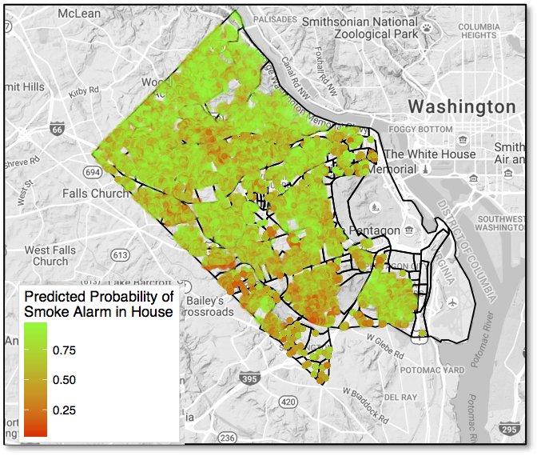
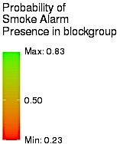
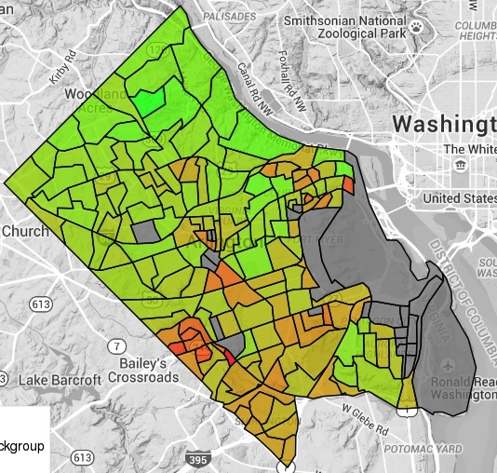
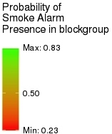
Probability of Having a Smoke Alarm
Bayesian Logistic Regression Model with
Conditionally Autoregressive Spatial Effects
Census Block Level Predictions
Housing Unit Level Predictions
Notes:
Using a Bayesian logistic regression model to estimate the probability that a housing unit has a smoke alarm.
The results show that the Fire Dept. should focus on the southwest (bottom left hand corner) of Arlington.
This is an example of an issue that required mapping multiple sources of different kinds of data to inform a topic.

Slide 21
The Use of Social Media by the Army Population

Slide 22
Research Questions
Social media offers a new opportunity to capture Soldiers’ well-being and/or concerns about the Army.
Goal: Explore the use of social media by the U.S. Army population.
Are there differences in topics and sentiments across groups (e.g., Soldiers vs. family) and across social media venues?
Can we identify determinants of attrition and changes in policies through the chatter in social media?

Slide 23



Data & Methods
Facebook
34 Army/military related pages
Pages grouped in 6 categories: Army Bases, Official Army, Unofficial Army, Unofficial Military, Army Family, and Military Family
6,089,415 comments from 191,342 posts until July 5, 2016
Twitter
43,409 tweets from 1,296 users between 2014 to 2016
8,938 Army/military related hashtags
Youtube
68 videos on 10 different topics such as education (e.g., college, GI bill), health (e.g. suicide, PTSD), quality of life (e.g., life on base, mail, food), sexual assault of women, and transgender
9,791 comments from the videos
Notes:
The study focuses on Facebook, Twitter, and YouTube as they are the most commonly used social media platforms. They provide users with a free application programming interface (API) that facilitates the collection of the data.
Pablo Barbera, Michael Piccirilli and Andrew Geisler (2016). Rfacebook: Access to Facebook API via R. R package version 0.6.3. https://CRAN.R-project.org/package=Rfacebook
Jeff Gentry (2015). twitteR: R Based Twitter Client. R package version 1.1.9. https://CRAN.R-project.org/package=twitteR
Timothy Graham & Robert Ackland and with contribution from Chung-hong Chan (2016). SocialMediaLab: Tools for Collecting Social Media Data and Generating Networks for Analysis. R package version 0.22.0. https://CRAN.R-project.org/package=SocialMediaLab

Slide 24
Sentiment Comparisons
Facebook (dark blue) and Twitter (light blue) have strikingly similar sentiment.
The sentiments on YouTube (red) are more negative than either Facebook or Twitter.
This may be due to the increased anonymity afforded by YouTube.
Notes:
Jockers ML (2015). _Syuzhet: Extract Sentiment and Plot Arcs from Text_. <URL: https://github.com/mjockers/syuzhet>.

Slide 25
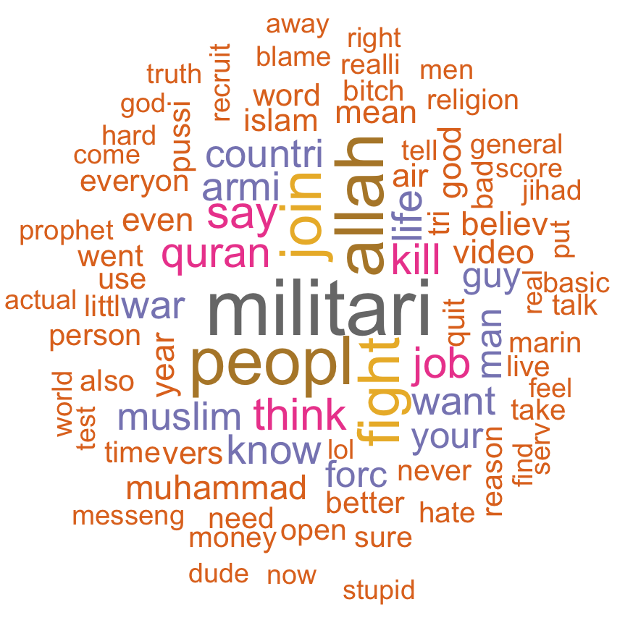
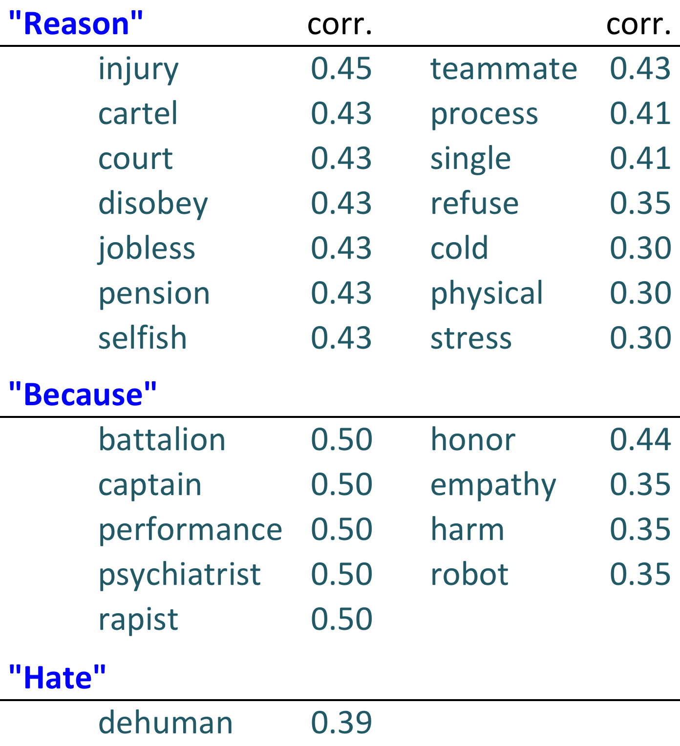
“Why I Quit the Army”
Identified 6 videos with titles related to Soldiers leaving the Army.
Analyzed the word frequencies and correlations between selected relevant words in the comments of these videos.
Notes:
*Words with correlations above/equal to 0.30 are reported
Words related to job, religion, war are used frequently.
Injury, pension, performance, stress are highly correlated with the words “reason”, “because”, “hate.”

Slide 26
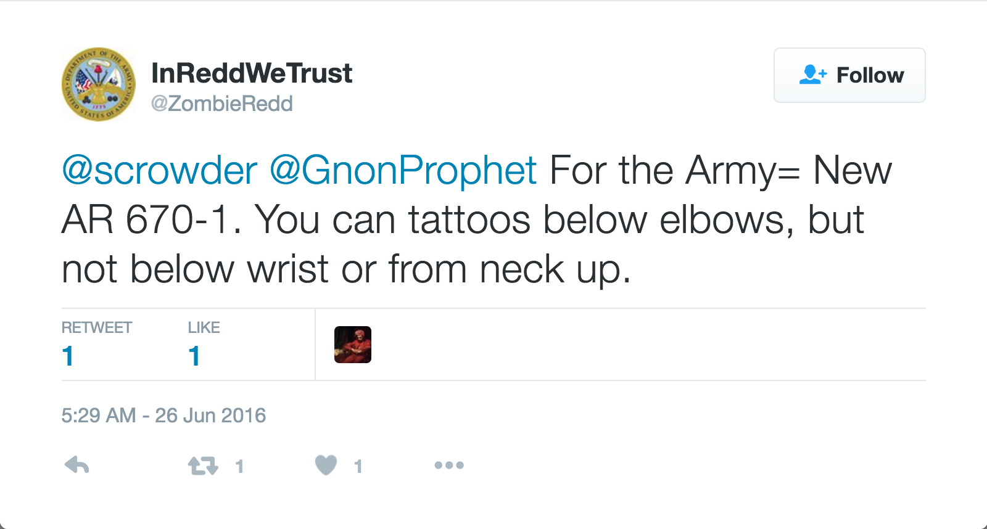
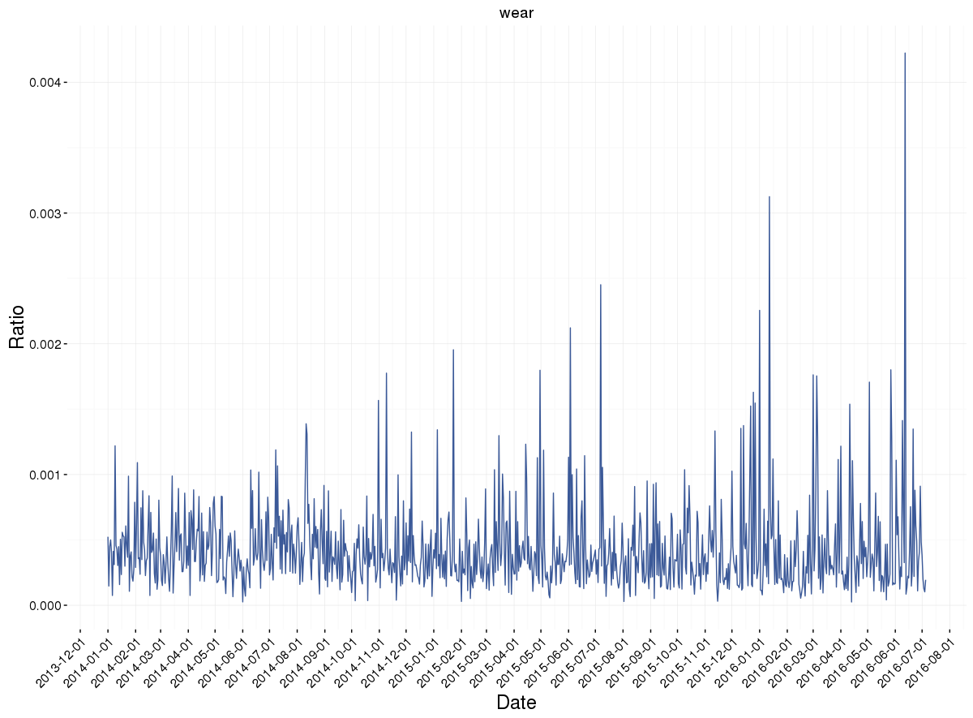
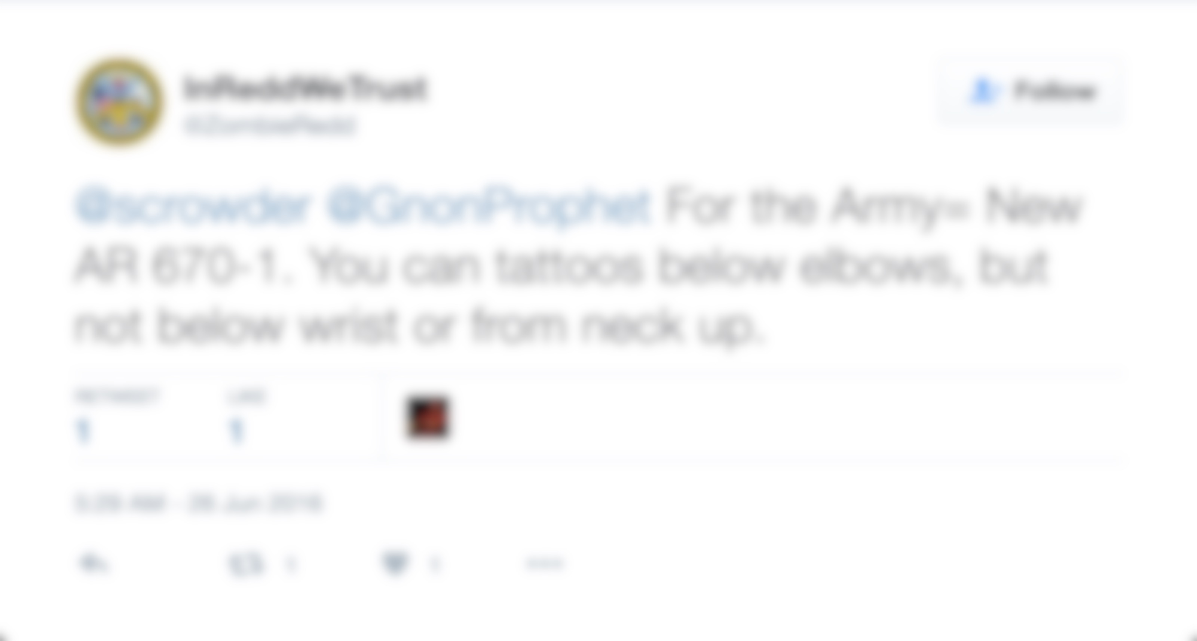


Identifying Policy Changes Over Time
The daily frequency of each word from 2014 to present was counted.
The spikes relevant to specific policies introduced/changed during the same period were identified.
As illustration, below plots display the frequency of the word “WEAR” on Facebook and Twitter; the peaks correspond to the dates of uniform policies.
???
The daily frequency of each word from 2014 to present was counted.
The spikes relevant to specific policies introduced/changed during the same period were identified.

Slide 27
School Assignment Policies & Race A comparison of Jefferson county & mecklenburg county school districts

Slide 28
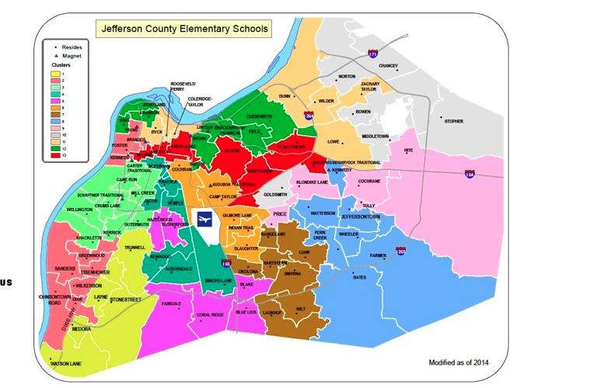
Policy Review
Jefferson County
Elementary School Clusters
1975: Kentucky Board of Education mandates a race-based busing system to promote desegregation.
2007: Meredith vs. Jefferson County Public School : Deemed unconstitutional to integrate schools solely on the basis of race. A new plan that aspires to create integrated clusters on the basis of income, family education level, and percent whiteness was developed and is currently in place.

Slide 29
Policy Review Continued
Mecklenburg County
Elementary School Assignment
1971: Swann vs. Charlotte-Mecklenburg Board of Education: The Supreme Court’s first metropolitan wide desegregation decision.
2002: Racial based integration ended. Public schools began to re-segregate and have remained so to present times. Students are assigned to schools solely based on geographic location.

Slide 30
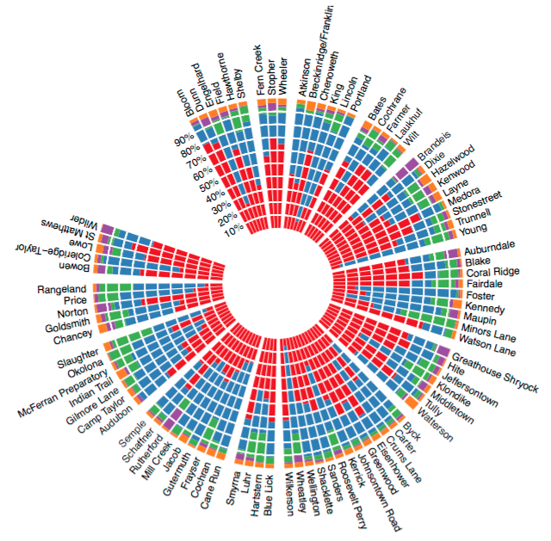
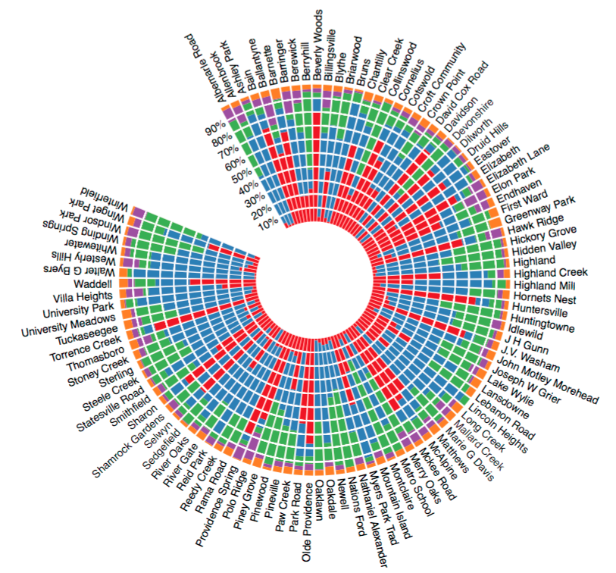
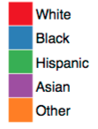
Racial Breakdowns by Elementary School
Race
Jefferson County
Mecklenburg County
Race
Race
Jefferson County
Jefferson County

Slide 31
Assessing the Influence of career & college readiness

Slide 32
Direct Evaluation of the Policy
Remedial Course Placement, All Districts Combined
Graduating Class | Math | English | Reading
2010 | 66% | 54% | 62%
2015 | 56% | 43% | 52%
Ratio Change | 15% ↓ | 20% ↓ | 16% ↓
Ratio Change = (2010 Placement – 2015 Placement)/2010 Placement

Slide 33
Differences in Remedial Placement by Race
Proportion of Students
Mathematics
English
Reading
White
Non-White
There was a general decline in remedial course placement across 2009-2014, however white students consistently performed better than non-white student

Slide 34
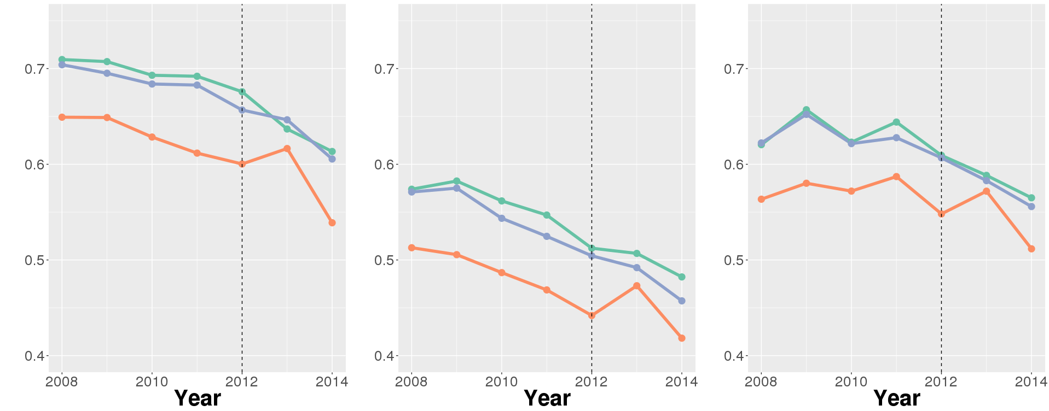
Differences in Remedial Placement by Career Readiness
Proportion of Students
Mathematics
English
Reading
Low
Medium
High
Districts with a higher proportion of Career Ready Students have a higher proportion of remedial course placement
Not much difference between High and Medium Career Ready Districts

Slide 35
Contacts
Organizers of the DSPG program: Dr. Gizem Korkmaz at gkorkmaz@vbi.vt.edu and Dr. Aaron Schroeder at aschroed@vbi.vt.edu
Applications related to DSPG Fellows Program: SDAL Administrative Services Coordinator, Kim Lyman at klyman@vbi.vt.edu or (571) 858-3100
Applications related to DSPG Honors Program: Biocomplexity Institute Education and Outreach Specialist, Dr. Shernita Lee at shernita@vbi.vt.edu or (540)-231-7531
Website: https://www.bi.vt.edu/sdal/careers/call-for-students

Slide 36
Other Quotes
“While classwork is heavy on numbers, being able to work directly with people at Arlington County government is eye-opening. It gives you a broader context and changes your world view.”
- Adrienne Rogers, of Blacksburg, Virginia, then a rising senior majoring in statistics and sociology at Virginia Tech
“I never realized how much time it takes to clean the data into the right form. Now I know and can really appreciate all the effort.”
- Will Sandholtz, then a rising junior at U of California, Berkeley
"All of our projects involved interesting issues with a clear need for statistical expertise, and a direct impact on the communities we worked with."

Slide 37
Other Quotes
“Our overarching objective is to equip new generations of scientists with skills they need to provide policymakers and government leaders with data analysis support that can inform difficult decisions related to healthcare, education, and social justice.”
- Sallie Keller, professor of statistics and director of the Social and Decision Analytics Laboratory
“It’s not easy to find a program like Data Science for the Public Good that combines my two majors — statistics and psychology. This is a great opportunity for me to work on an issue I am passionate about.”
- Emily Stark, who is hoping she can apply some of what she learns to education solutions in Tennessee, where she attends college

Slide 38
Diversify Your Expertise
Work in cross-disciplinary teams, closely supported by graduate research assistants and supervised by faculty.
Individualized mentors in a wide variety of fields: statistics, social, behavioral and economic sciences, computer science, simulation, data analytics, information technology policy, and infrastructural resilience.
"The interdisciplinary work environment made it easy to connect and have conversations. If I wanted to ask a question about another field of research, there was always a door I could knock on.”
- DSPG Fellow 2016

